Slide 1
Final Project in Python

Slide 2
z-tests
One proportion
Two proportion
Compare one thing to a whole
One categorical component
Compare ratio to a whole
Two categorical components

Slide 3
Code for z-tests
count = # or np.array([#, #])
nobs = # or np.array([#,#])
value = # (only for one proportion!)
stat, pval = proportions_ztest(count, nobs, value)
print(stat,pval)

Slide 4
Independent Chi-Square
Both IV and DV are categorical
Comparing frequencies by category

Slide 5
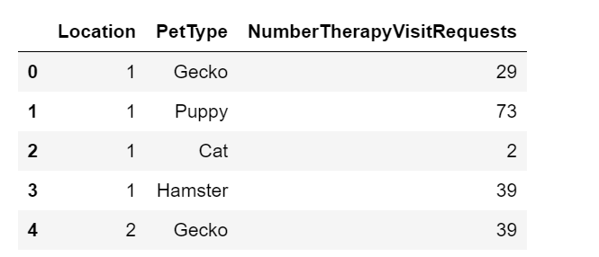
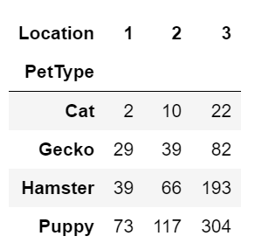
Making a Pivot Table
TableName = pd.pivot_table(dataFrame, index=“column”, columns=“column”, values=“column”)

Slide 6
Using the Pivot Table in a Chi-Square
stats.chi2_contingency(pivotTable)

Slide 7
One Way ANOVAs
One categorical IV
One continuous DV
Comparing means of the categories

Slide 8
I’m melting…
Melt is a type of reshaping
NewDataFrame = pd.melt(dataFrame, var_name=“column1”, value_name=“column2”)

Slide 9
Data Wrangling and Assumption Testing
Recode categories to numbers
Check normality and adjust
Check for homogeneity of variance

